Slide 1

CSS Fundamentals
.NET

Slide 2
CSS (Cascading Style Sheets) is a language that describes the style HTML elements are to be displayed in on screen. CSS is stored in a stylesheet, which is a .css file
https://www.w3schools.com/css/css_intro.asp

Slide 3

CSS – Why use CSS?
HTML is not intended to be responsible for style and formatting.
Style Formatting tags were added with HTML 3.2.
Development of large websites became a laborious process with fonts and color information added to every page.
The World Wide Web Consortium (W3C) created CSS to enable separation of concerns between structure and presentation of documents (HTML + CSS).

Slide 4
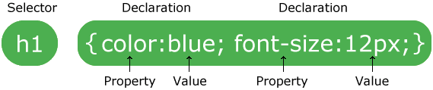
CSS – Syntax https://www.w3schools.com/css/css_syntax.asp
A rule or "rule set" is a statement that tells browsers how to render particular elements on an HTML page.
The selector points to the HTML element you want to style,
The declaration block begins with ‘{‘, contains declarations separated by ‘;’, and ends with ‘}’.
Each declaration includes a CSS property name and a value, separated by a colon.

Slide 5
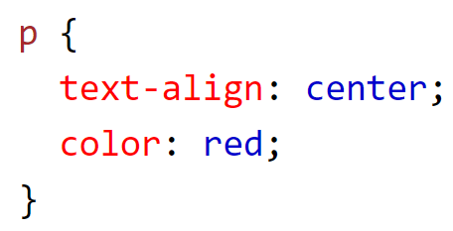
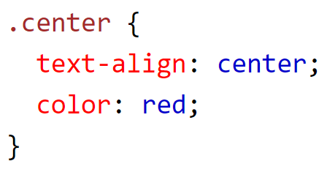
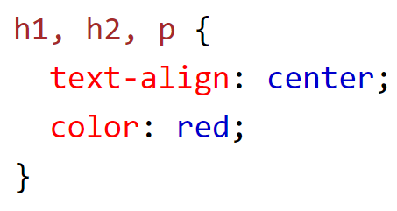
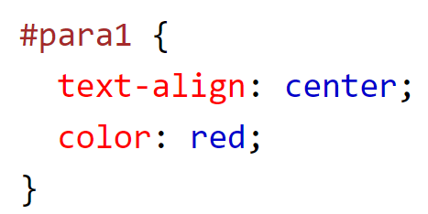
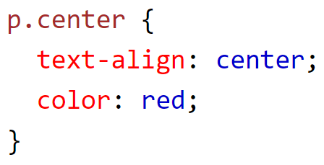
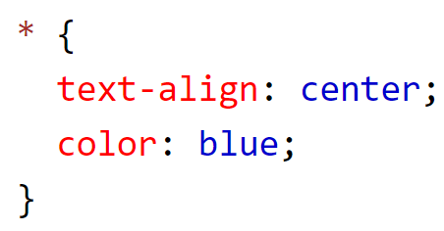
CSS – Selector https://www.w3schools.com/css/css_selectors.asp
Selector Type | Example | Description
element Selector | p { declarations } | Selects HTML elements based on the element name.
id Selector | #para1 { declarations } | Selects HTML elements based on the id name.
class Selector | .center { declarations } | Selects HTML elements based on the class attribute.
Universal Selector | * { declarations } | Selects all HTML elements on the page.
Selector List | h1, h2, p { declarations } | Selects all named HTML elements in the document.
Concatenation | p .center { declarations } | Selects all center class elements inside a <p> element in the document.

Slide 6
CSS – Pseudo-Selectors https://www.w3schools.com/css/css_pseudo_classes.asp
There are two types of Pseudo-Selectors.
Pseudo-Class Selectors and Pseudo-Element Selectors.
A CSS pseudo-element is used to style specified parts of an element, like the first letter (or line) of an element.
A CSS pseudo-class is used to define a special state of an element, like display a visited link differently or change an elements color when the mouse hovers over it.

Slide 7
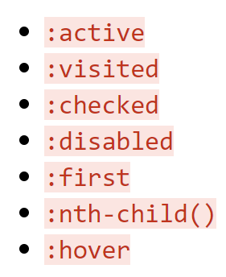
CSS – Pseudo Classes https://www.w3schools.com/css/css_pseudo_classes.asp
A pseudo-class is a specific keyword at the end of a selector used to specify that you want to style the selected element but only when it is in a certain state.
when the user is hovering the mouse over the element
when a checkbox is disabled or checked.
The syntax is to use a colon (:) to precede the pseudo-class. These are among over 30 pseudo classes available.

Slide 8
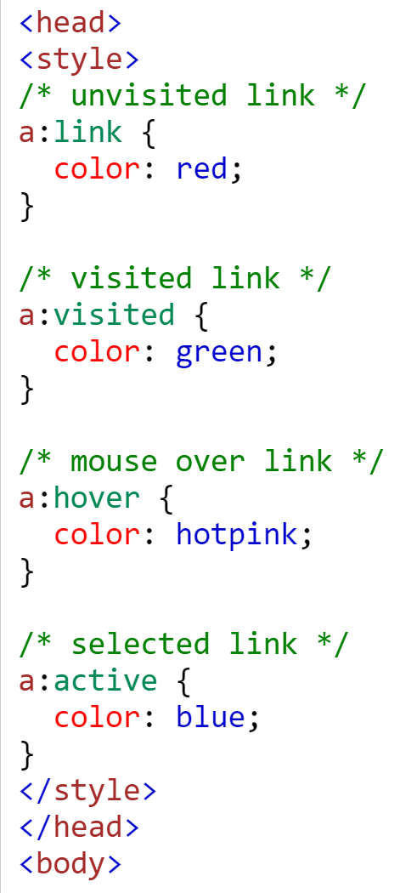

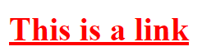
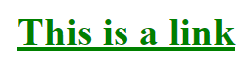
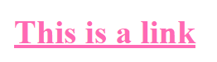

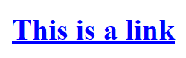
CSS – Pseudo Classes Examples https://www.w3schools.com/css/css_pseudo_classes.asp

Slide 9
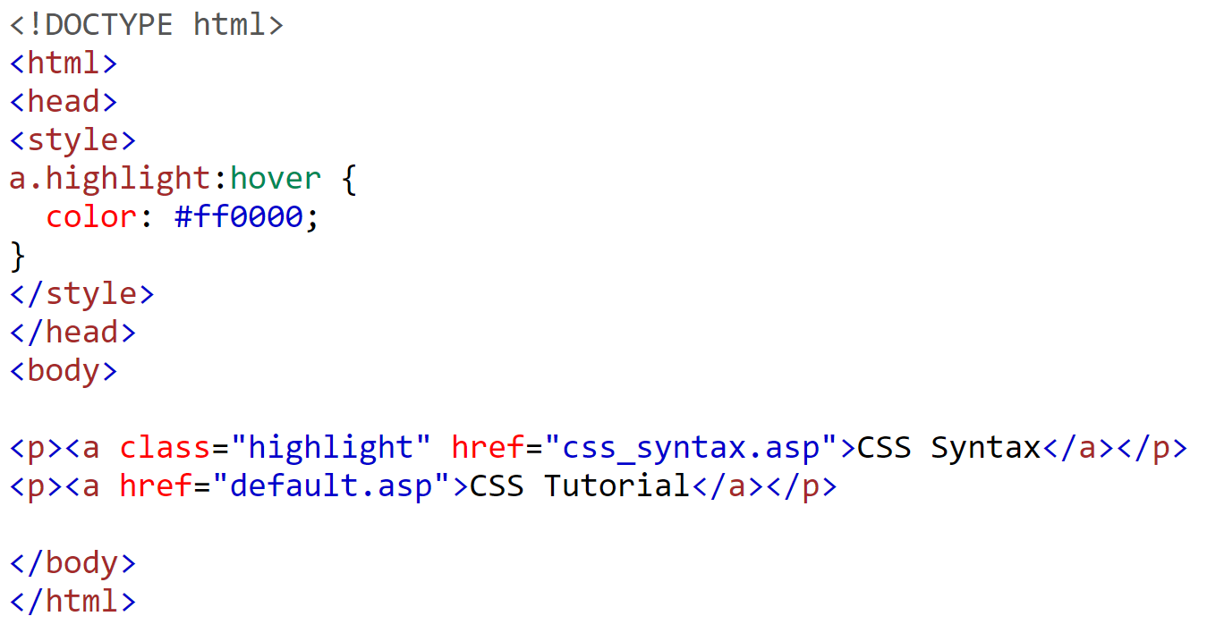
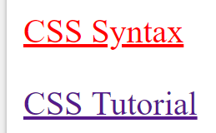
CSS – Pseudo Classes with HTML Classes https://www.w3schools.com/css/css_pseudo_classes.asp
Pseudo Classes can be combined with HTML Classes to be more specific as to which elements you want to style.

Slide 10
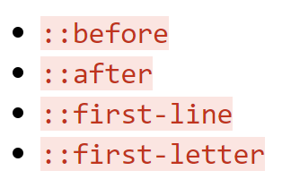
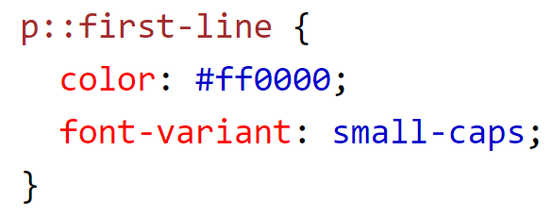
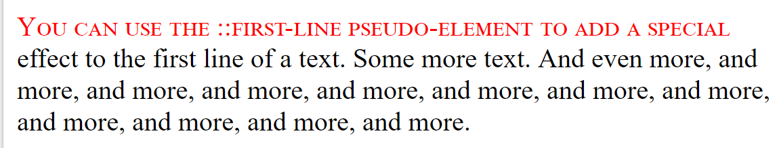
CSS – Pseudo Elements https://www.w3schools.com/css/css_pseudo_elements.asp
A CSS pseudo-element is used to style specified parts of an element. You must have two ‘::’ between the element and the pseudo element.
Style the first letter, or line, of an element
Insert content before, or after, the content of an element
This example formats the first line of the text in all <p> elements:

Slide 11
CSS – Combinators https://www.w3schools.com/css/css_combinators.asp
A combinator describes the relationship between two selectors. The selector part of a CSS selector/declaration block can contain more than one selector. Between the selectors, we can include a combinator. There are four combinators to choose from.
Selector | Symbol | Description
descendant selector | (space) | Matches any descendant element (nested inside) of a specified element. This includes grandchildren, etc
child selector | (>) | Selects only elements that are the children of a specified element.
adjacent sibling selector | (+) | Selects the designated element if it occurs immediately after this selector. Sibling elements must have the same parent element.
general sibling selector | (~) | Selects all sibling elements.

Slide 12
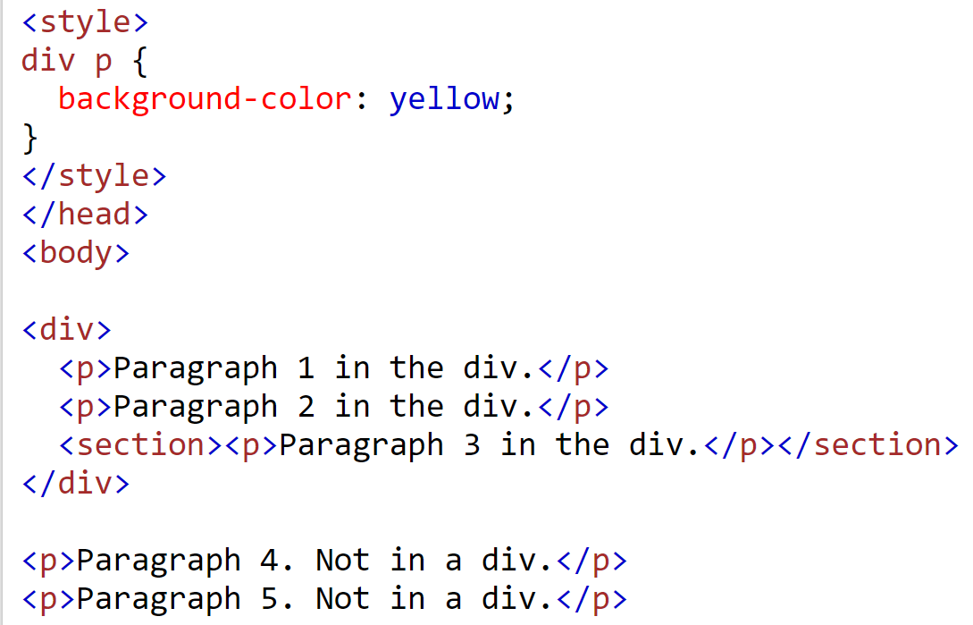
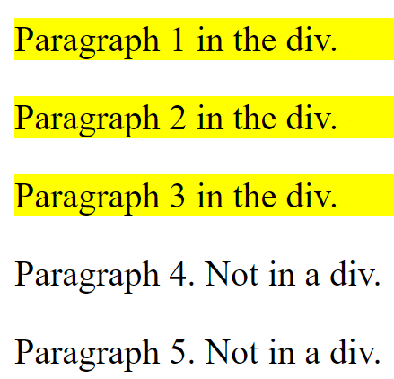
CSS – Combinators - Descendent https://www.w3schools.com/css/css_combinators.asp

Slide 13
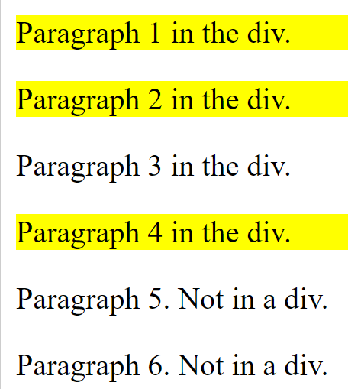
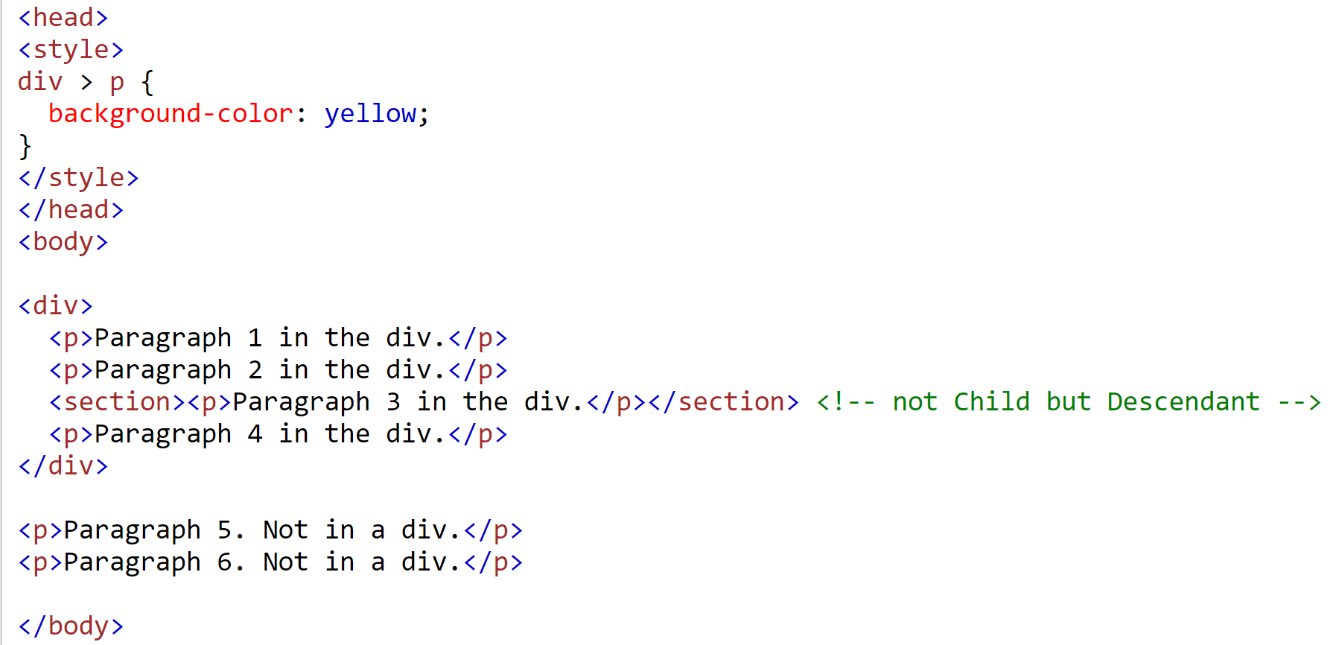
CSS – Child Combinators https://www.w3schools.com/css/css_combinators.asp

Slide 14
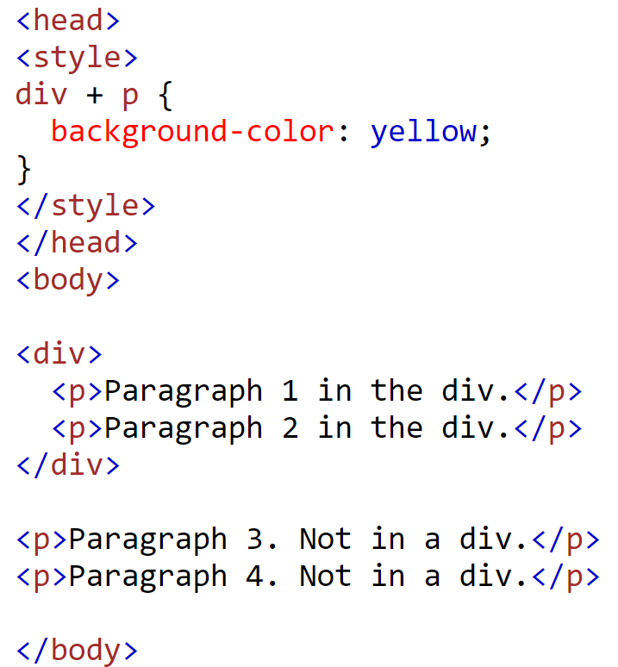
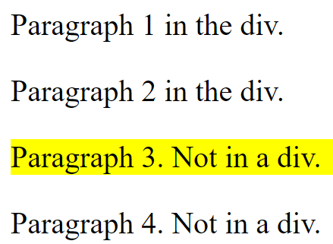
CSS – Adjacent Sibling Combinators https://www.w3schools.com/css/css_combinators.asp

Slide 15
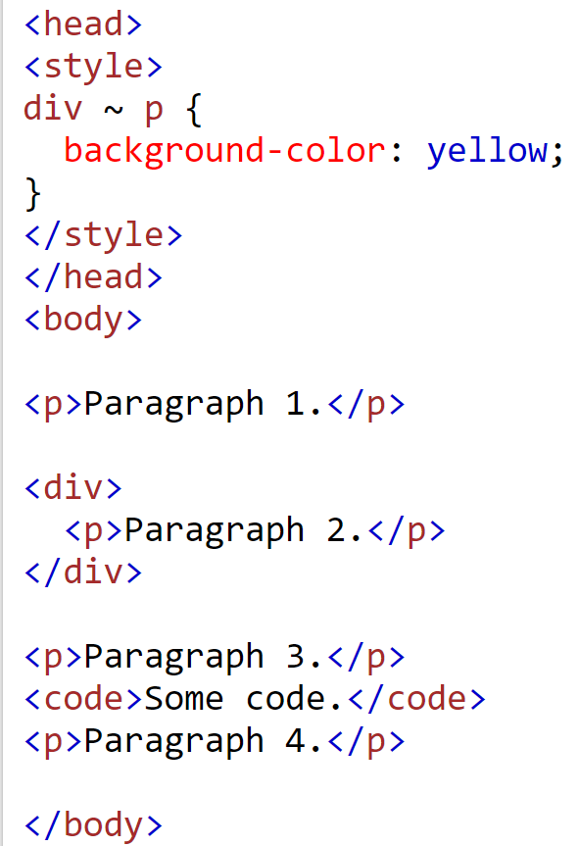
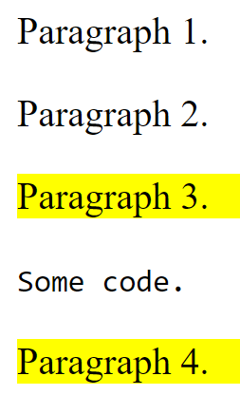
CSS – General Sibling Combinators https://www.w3schools.com/css/css_combinators.asp

Slide 16
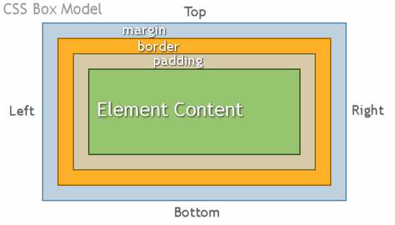
CSS - Box Model https://www.w3schools.com/css/css_boxmodel.asp
The CSS box model is the way that all HTML elements are defined. There are 4 different concentric boxes, which are
Content - this is the actual text or image
Padding - space between content and border
Border - space between padding and margin - its width, style, and color properties may be set
Margin - usually invisible space between the end of one element and the start of another
The size of each edge is usually given in pixels.

Slide 17
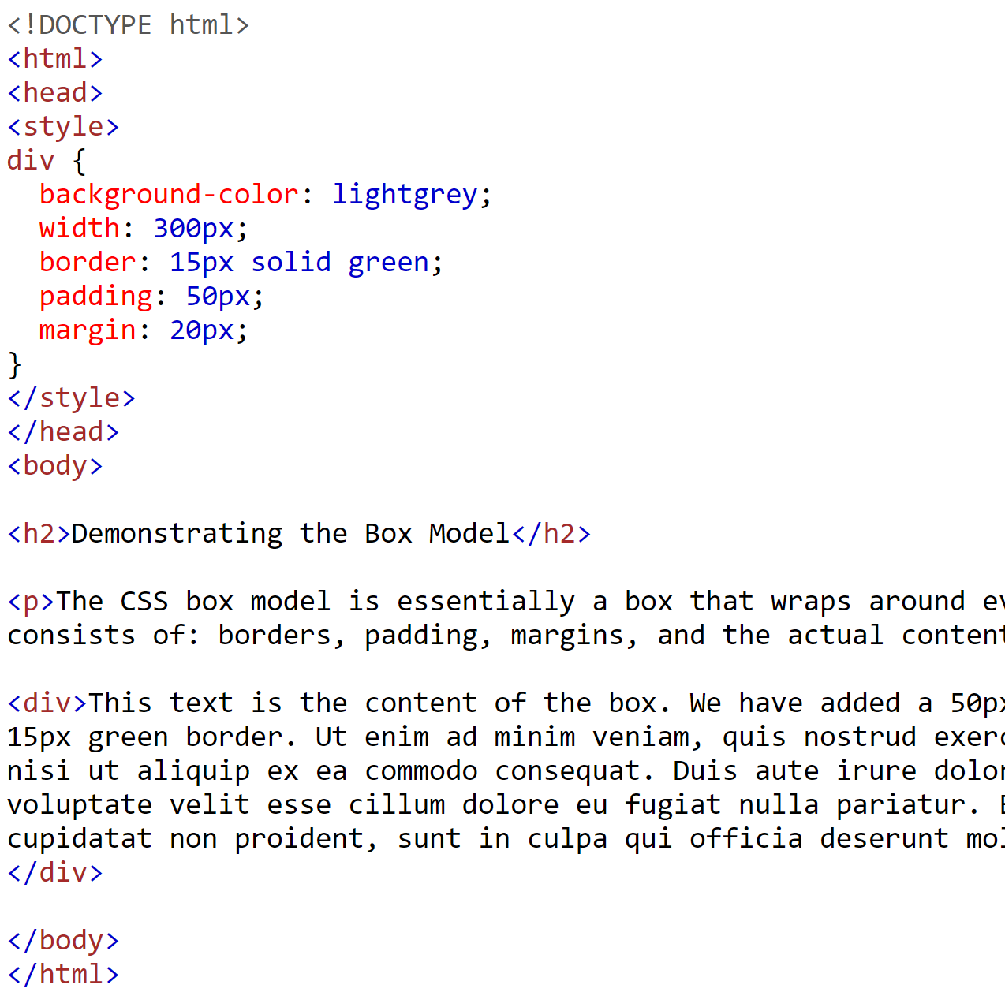
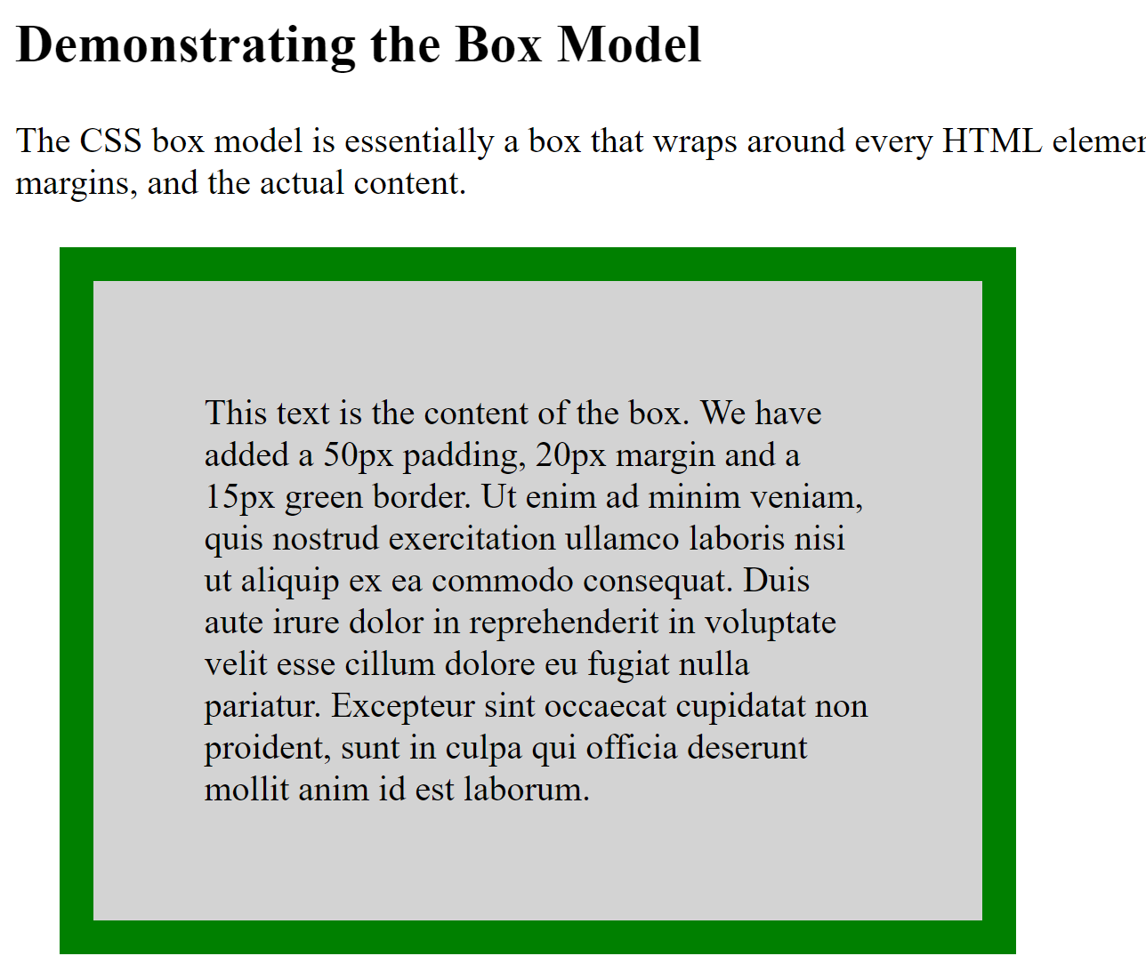
CSS - Box Model Example https://www.w3schools.com/css/css_boxmodel.asp

Slide 18
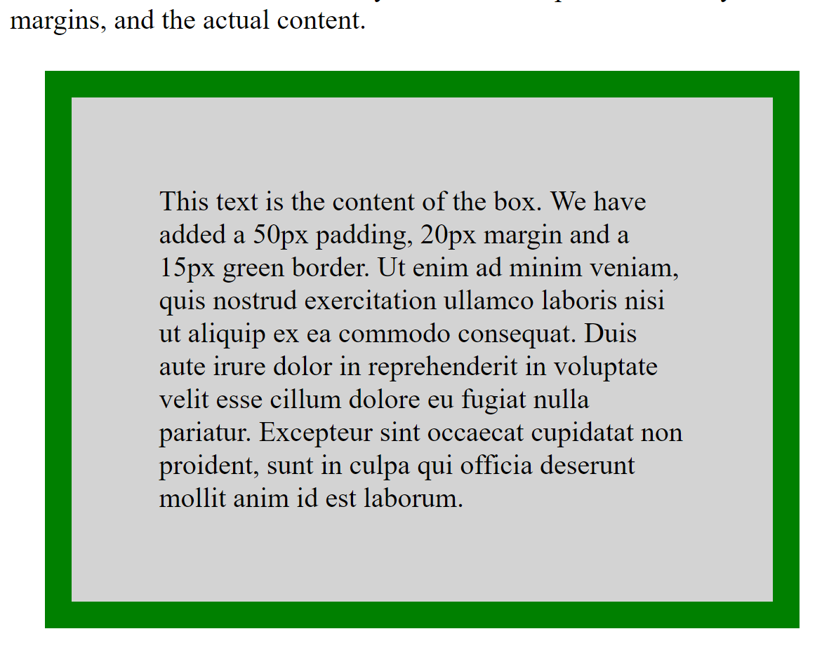
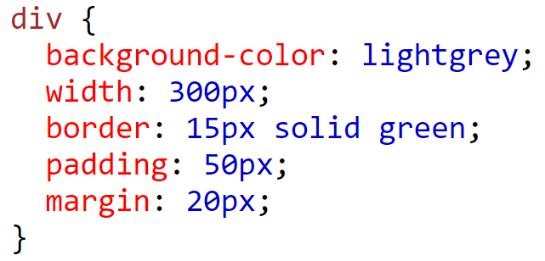
CSS Box Model – Example https://developer.mozilla.org/en-US/docs/Web/CSS/Shorthand_properties
In order to correctly set the width and height of an element, you must know how the box model works.
margin
border
padding
width
300px (width)
+ 30px (left + right border)
+ 100px (left + right padding)
+ 40px (left + right margin)
= 470px total element width

Slide 19
CSS – Units of measurement
There are two ways to give measurement in CSS. Both absolute and Relative have their uses.
Absolute
px | pixels
mm | millimeters
cm | centimeters
In | inches
Pt | points(1/72 of an inch)
Pc | picas (12 points)
Relative
% | percentage relative to parent element's width
em | 1em is the same as the font size( scales with it) of the current element
rem | stands for "root em" and works the same except refers to the base font size
vh, vw | these are 1/100th of the height and width of the viewport, respectively
Most common

Slide 20
CSS - Colors
There are four ways color can be set in CSS.
Colors
keywords | ‘red’, ‘blue’, ‘aquamarine’, etc
hex value | # sign followed by six hex numbers (0-F) with each pair representing rgb values for up to 256 different values of each.
rgb(r,g,b) | a function to specify values for red, green, and blue. Ex. rgb(224,176,255). Optional alpha (transparency) value.
hsl(h,s,l) | a function to specify hue, saturation, and lightness values to define a color. Ex. hsl(240,100%,50%). Optional alpha (transparency) value. This isn’t used very much.

Slide 21
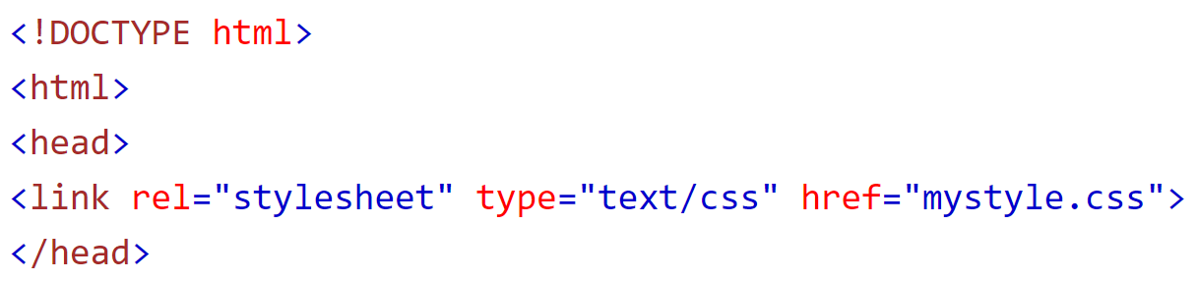
CSS - Three Ways To Include Styling https://www.w3schools.com/css/css_howto.asp
Styling Precedence – Inline overrides Internal/External, overrides Browser default styling.
External CSS file (Recommended) :
Include a reference to the relative location of the .css file inside a <link> element, inside the head section.
Benefits of External CSS.
Separation of concerns - HTML and CSS are in separate documents, you don't have to mix them
Reusability - the same stylesheet can be used to style many HTML files
Central location - Change styling in one place!
Readability - HTML is less cluttered, and CSS styling is easier to understand.

Slide 22
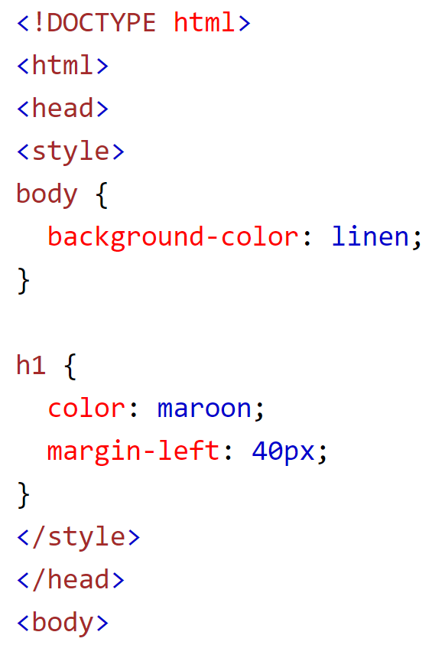
CSS - Three Ways To Include Styling https://www.w3schools.com/css/css_howto.asp
Internal CSS :
defined inside the <style> element, inside the head section.

Slide 23
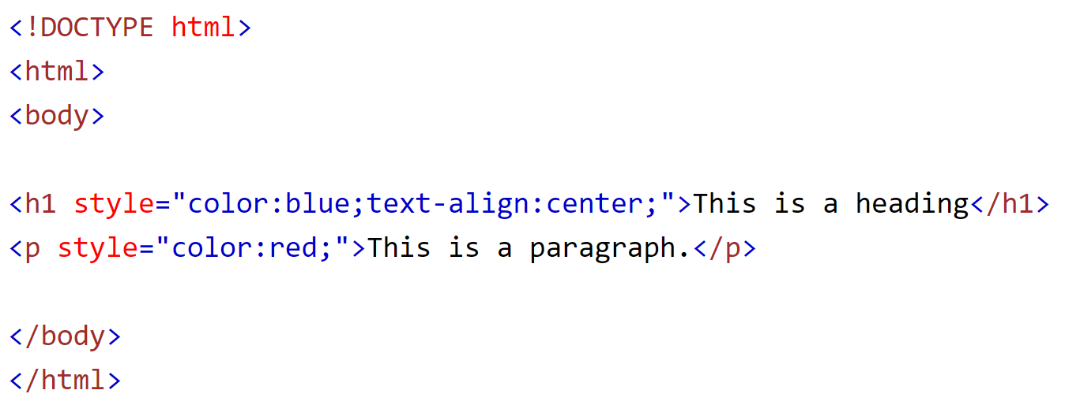
CSS - Three Ways To Include Styling https://www.w3schools.com/css/css_howto.asp
Inline CSS :
used to apply a unique style to a single element,
add a style attribute inside relevant element opening.

Slide 24
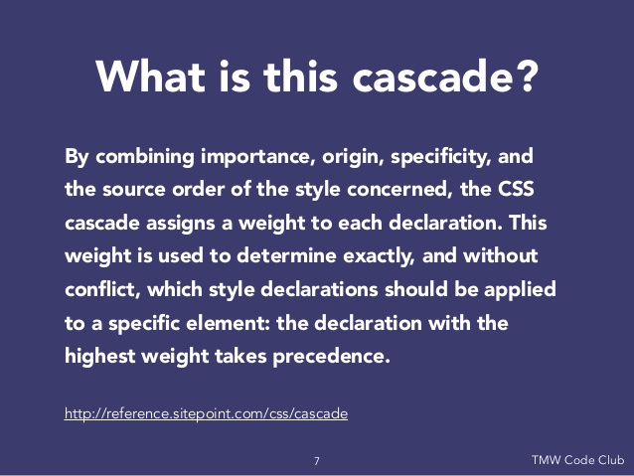
CSS - Rule Sets
What happens when you have two CSS rules that conflict with each other?
The order that selectors are chosen for styling depends on three things:
Importance
Specificity
Source order

Slide 25
CSS – Importance (!important)
There is a special CSS flag you can use to ensure that a style always gets applied - the !important flag.
div { color: red !important; } /* always applied */
The only way to override an !important flag is to apply another !important flag on a selector with the same specificity later in the document, or on a selector with greater specificity.
*!important is not best practice. Use Specificity instead.

Slide 26
CSS - Specificity
Specificity is a measure of how specific a selector is - basically, how many elements the selector could match. The selector with the most specificity will be applied over other selectors.
Each kind of selector is listed below in order of least to most specific:
No selector / inline (declared inside style attribute)
ID selector
Class / attribute / pseudo-class selector
Element or pseudo-element selector
The following CSS styles determine which rule will be applied.
div { color: red; } /* least specific - won't be applied */
#yellow { color: yellow; } /* most specific - this style will be applied */
.green { color: green; } /* in the middle - won't be applied */

Slide 27
CSS – Source Order
If two selectors have the same importance level and specificity, then the latter rule wins over earlier one. For example:
div { color: blue; } /* This comes first, will lose */
div { color: red; } /* comes last. This style is applied */
If you mix an external stylesheet with internal styling, the internal styling will win.

Slide 28
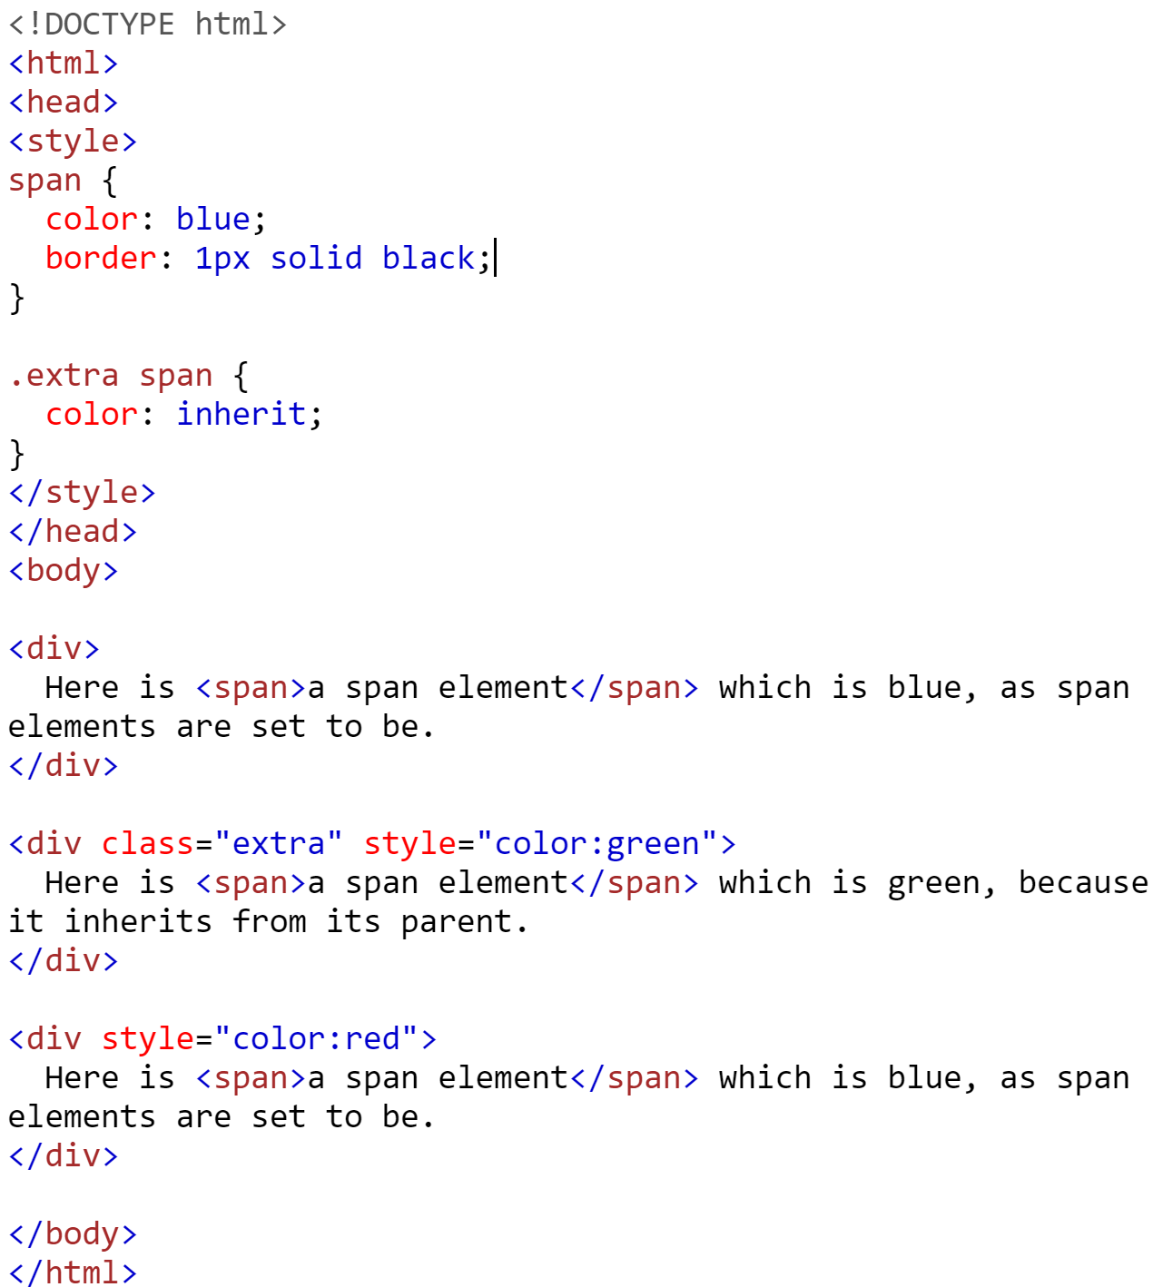
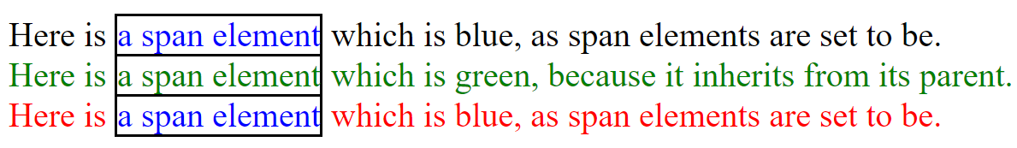
CSS – Inherit Keyword https://www.w3schools.com/cssref/css_inherit.asp https://developer.mozilla.org/en-US/docs/Learn/CSS/Building_blocks/Cascade_and_inheritance
The widths, margins, padding, and borders of elements do not automatically inherit styling from their parents.
The inherit keyword specifies that a property shall inherit its value from its parent element.
The inherit keyword can be used for any CSS property, and on any HTML element.

Slide 29
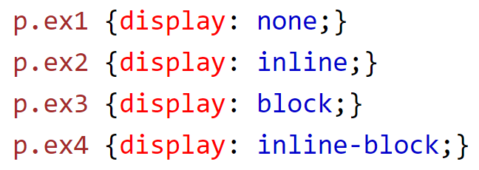
CSS – display Property https://www.w3schools.com/cssref/pr_class_display.asp
The display property defines the display type of an element. This overrides whatever default display values are defined for the property.
Note: you can also use the visibility: hidden property to hide an element. The difference is that display: none removes the element from the page completely whereas visibility: hidden means that the tag is allocated space on the page, but just isn't seen.
inline - display on the same line as other elements
block - start on a new line and
flex - make the element a flexbox
none - do not display the element at all

Slide 30
CSS – position Property https://www.w3schools.com/cssref/pr_class_position.asp
The position property specifies the type of positioning method used for an element.
The position property is an important property related to layout on a webpage. It governs the flow of elements. You can take elements out of the normal flow of the page to appear where you want.
Here are some position property values you should know:
static – (default) the element is placed in the normal document flow
relative - the element occurs in its normal place, but can be moved around with top, bottom, left, and right properties
absolute - removes the element from the normal flow of the document, fixes it in place relative to the html element or nearest positioned ancestor
fixed - fixes element in place relative to browser window.
sticky - hybrid between relative and fixed, allowing relative positioning until scrolled to a ‘threshold’ point

Slide 31
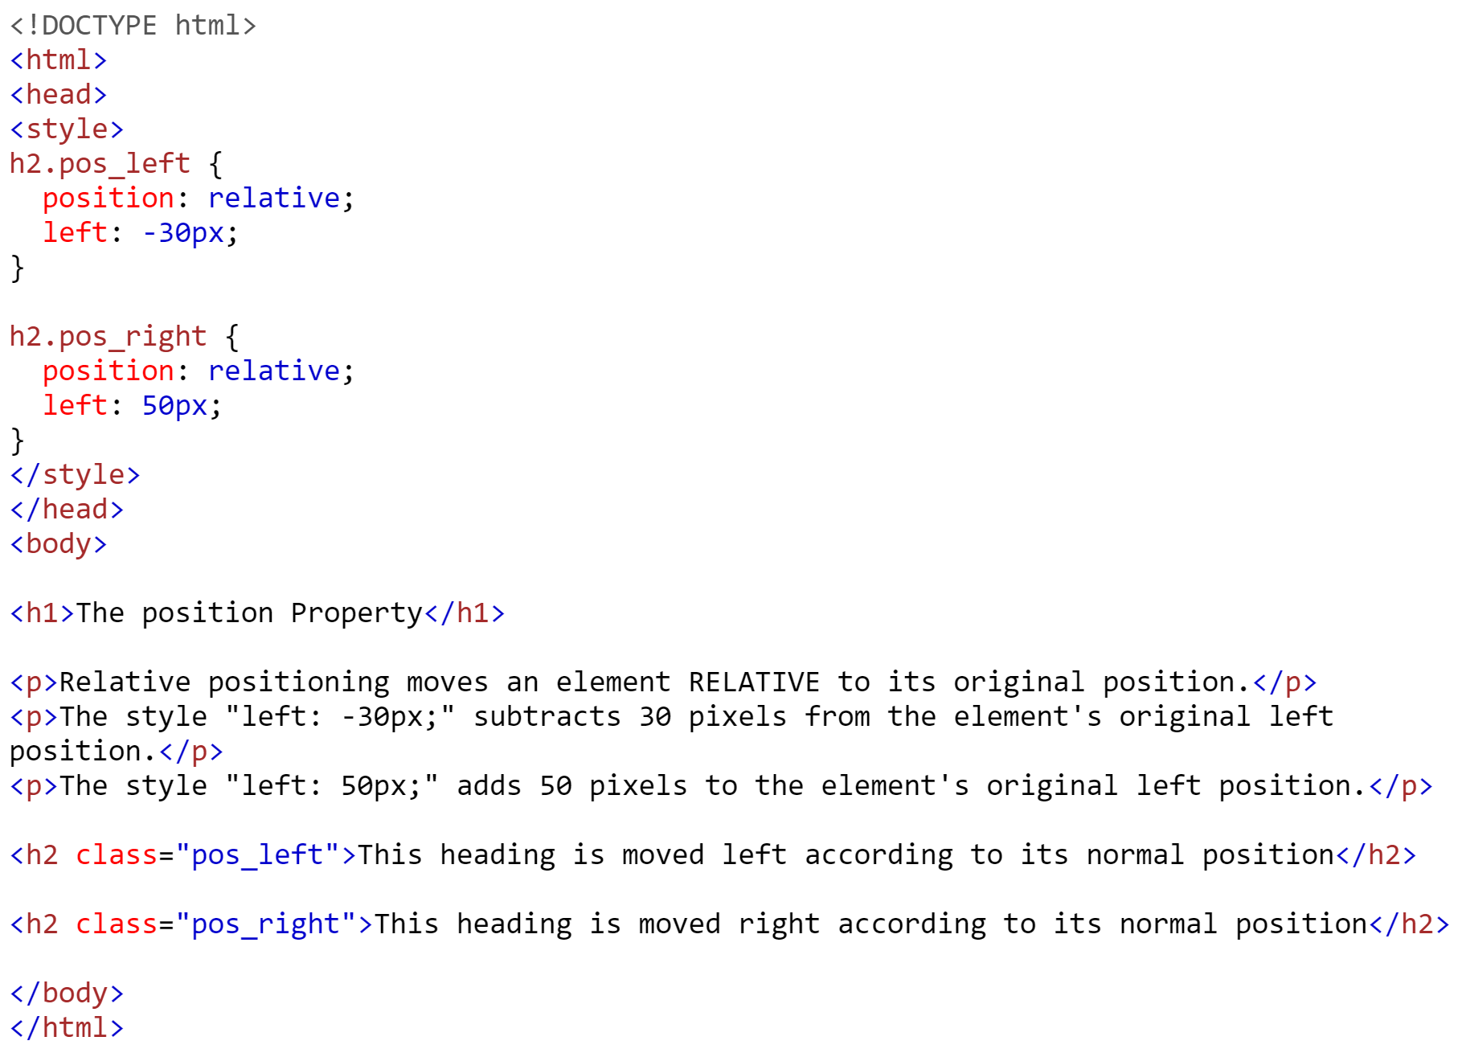
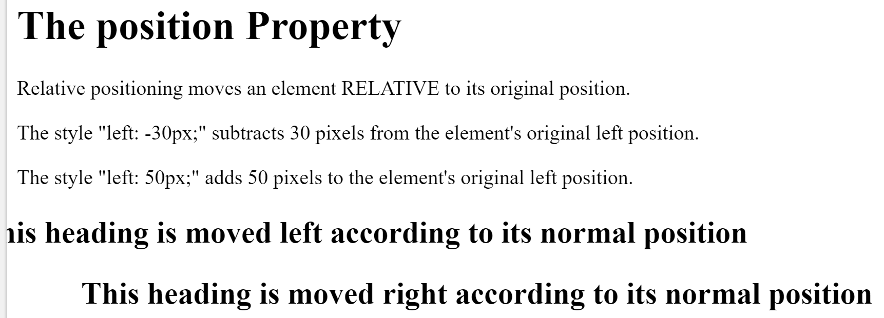
CSS – position Property example https://www.w3schools.com/cssref/pr_class_position.asp

Slide 32
CSS - Responsive Web Design
Responsive Web Design is a way of designing web pages so that they render well on any window, screen, or device size. RWD has become increasingly important due to the share of internet traffic conducted from mobile phones and devices.
There are a few ways to design web pages to change based on the size of the screen.
Use fluid grid systems - make your element containers sized with relative units like percentages instead of absolute units
Use flexible images which are also sized relatively to prevent rendering outside their container
Use media queries to change CSS based on the window size

Slide 33
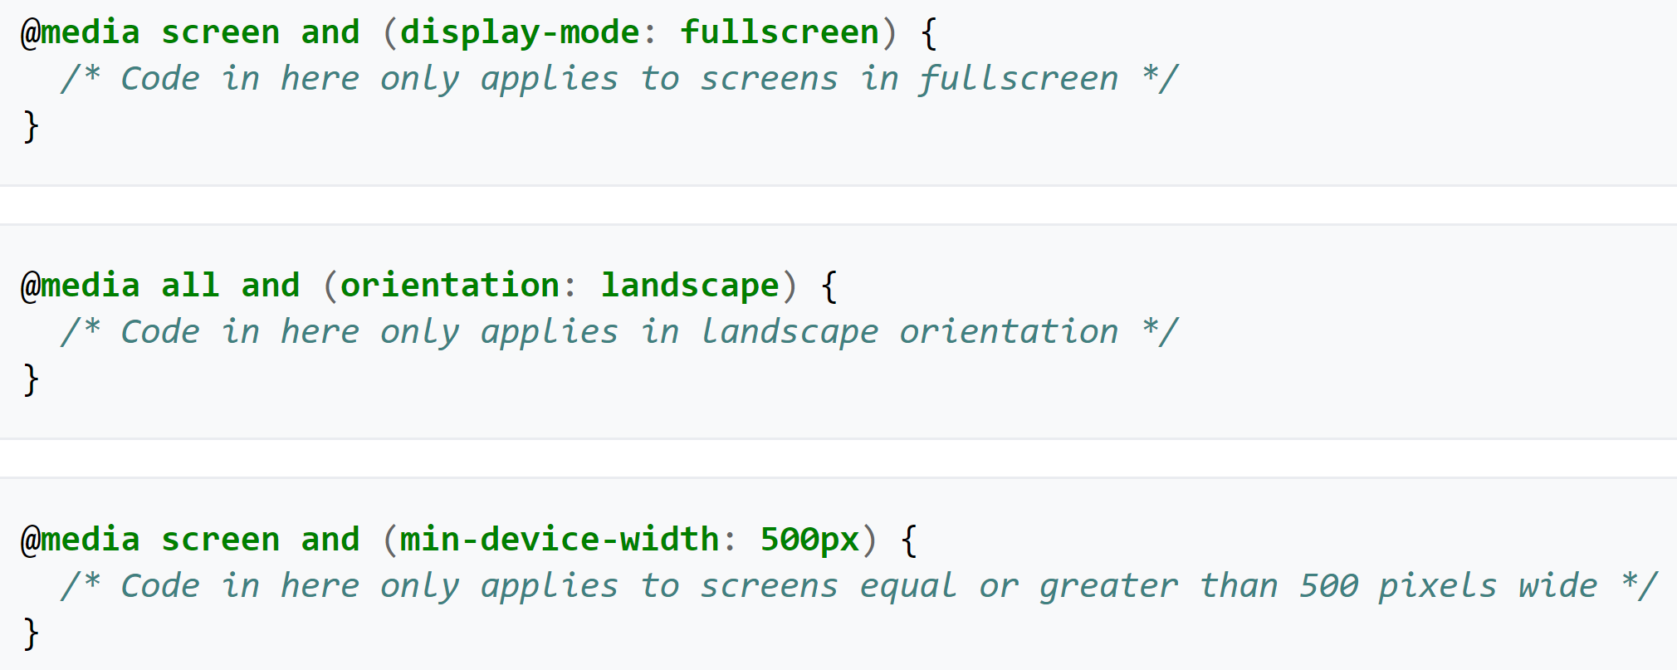
CSS - Media Queries https://en.wikipedia.org/wiki/Media_queries
Media queries are a way of adapting the display of CSS for different screen sizes. They can be used to respond to different media types and features. An example of the syntax is shown below:
A media type can be declared in the head of an HTML document using the "media" attribute inside of a <link> element. The value of the "media" attribute specifies on what device the linked document will be displayed

Slide 34
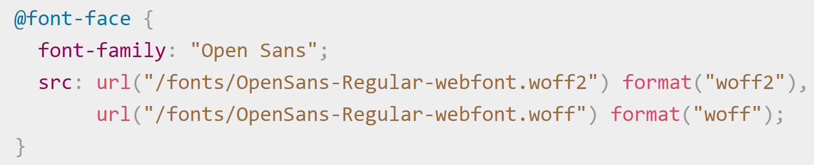
CSS – ‘at-rules’
A media query is one type of @rule. These tell CSS what to do in some way. The most important ones are:
@media - used for media queries
@font-face - used for defining a custom font
@keyframes - used for animations in CSS

Slide 35
CSS3 https://developer.mozilla.org/en-US/docs/Archive/CSS3 https://makeawebsitehub.com/css3-mega-cheat-sheet/
CSS Level 2 needed 9 years to reach the Recommendation status. This was because a few secondary features held back the whole specification.
In order to accelerate the standardization of non-problematic features, the CSS Working Group of the W3C divided CSS in smaller components called modules .
Each of these modules is now an independent part of the language and moves towards standardization at its own pace.
While some modules are already W3C Recommendations, other still are early Working Drafts. New modules are added when new needs are identified.
CSS3 is still evolving but some features are available such as:
rounded corners, shadows, gradients, transitions and animations, flexbox layouts

